Slide 1
Random Forest
Marwa Sonbul

Slide 2
Motivating Random Forests: Decision Trees
Random forests are an example of an ensemble learner built on decision trees.
For this reason we'll start by discussing decision trees briefly.

Slide 3
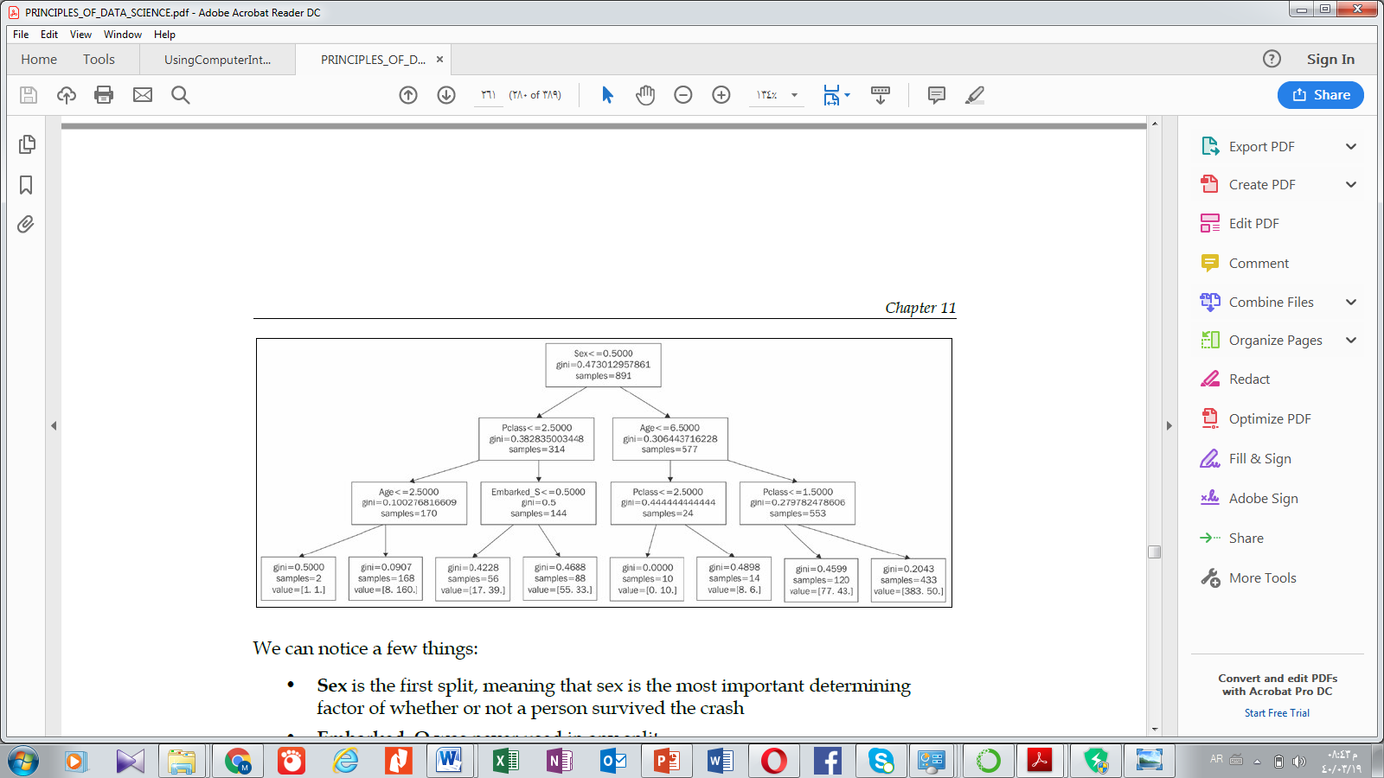
Decision Trees: - It is a tree-like graph, a sequential diagram illustrating all of the possible decision alternatives and the corresponding outcomes. - Starting from the root of a tree, - every internal node represents what a decision is made based on; each branch of a node represents how a choice may lead to the next nodes; and finally, each terminal node, the leaf, represents an outcome yielded. Type of Trees : classification, regression
Best depth is 3
At depth 5 , over fitting occurs

Slide 4
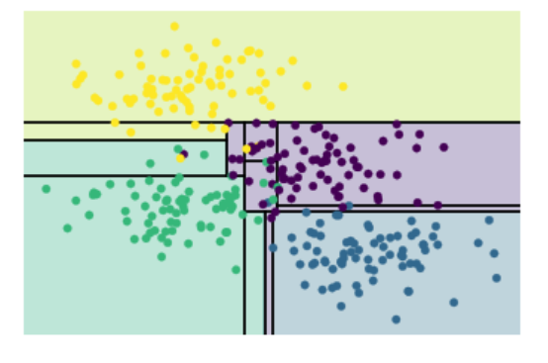
Notice that as the depth increases, we tend to get very strangely shaped classification regions; for example, at a depth of five, there is a tall and skinny purple region between the yellow and blue regions. It's clear that this is less a result of the true, intrinsic data distribution, and more a result of the particular sampling or noise properties of the data. That is, this decision tree, even at only five levels deep, is clearly over-fitting our data.
depth 5

Slide 5
Disadvantages of Decision Trees
Can easily overfit the training data (tuning is required)
Decision trees can be unstable because small variations in the data might result in a completely different tree being generated. This problem is mitigated by using decision trees within an ensemble (Random Forest).

Slide 6
Decision trees and over-fitting
Such over-fitting turns out to be a general property of decision trees: it is very easy to go too deep in the tree, and thus to fit details of the particular data rather than the overall properties of the distributions they are drawn from.
Notice that as the depth increases, we tend to get very strangely shaped classification regions; for example, at a depth of five, there is a tall and skinny purple region between the yellow and blue regions.
That is, this decision tree, even at only five levels deep, is clearly over-fitting our data.

Slide 7
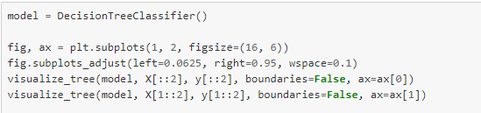
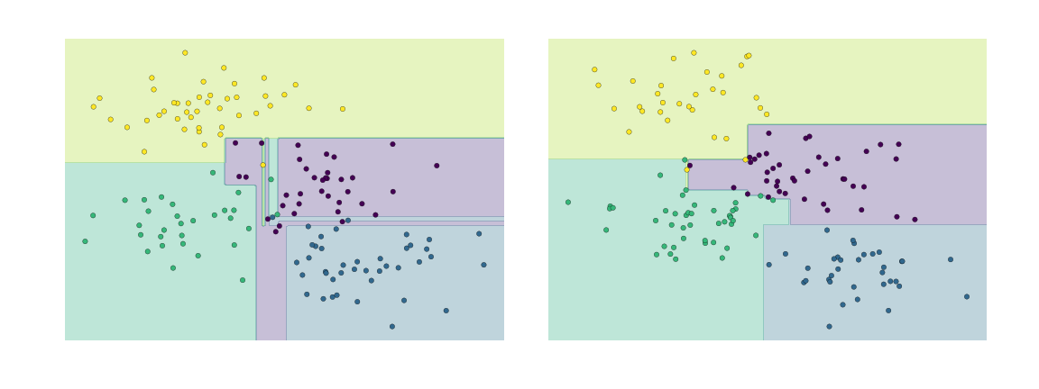
Ensemble Trees:
Notes:
نتائج ال 2 trees متشابهة جدا.. بالتالي الأفضل أدمجهم و اجمعهم للحصول على نتائج أفضل

Slide 8
Ensemble Trees:
It is clear that in some places, the two trees produce consistent results (e.g., in the four corners), while in other places, the two trees give very different classifications (e.g., in the regions between any two clusters). The key observation is that the inconsistencies tend to happen where the classification is less certain, and thus by using information from both of these trees, we might come up with a better result!
Notes:
نتائج ال 2 trees متشابهة جدا.. بالتالي الأفضل أدمجهم و اجمعهم للحصول على نتائج أفضل

Slide 9
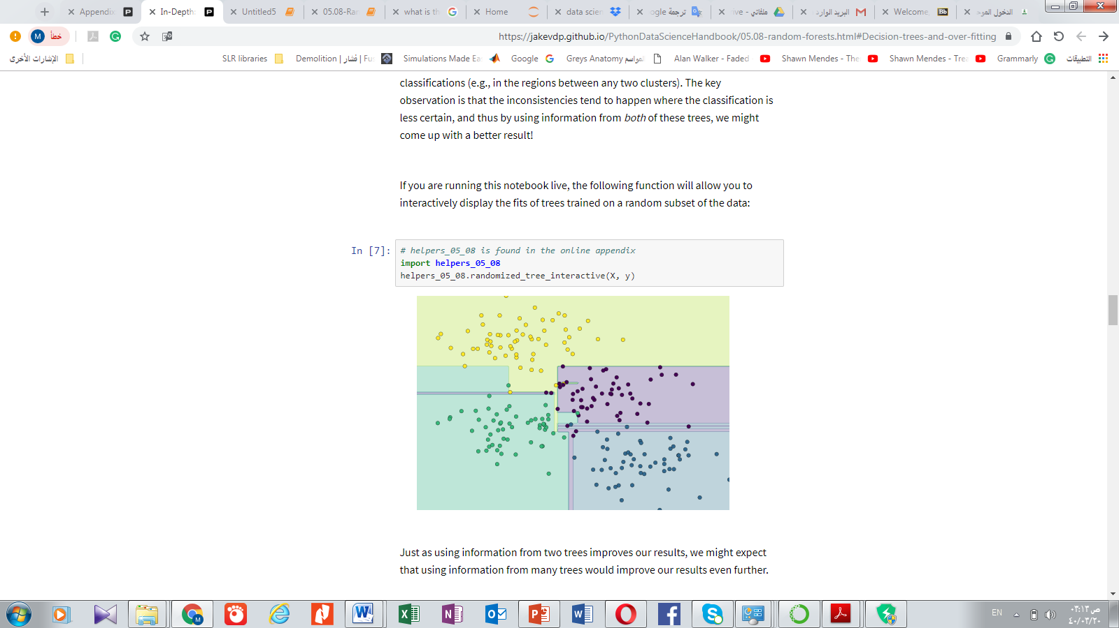
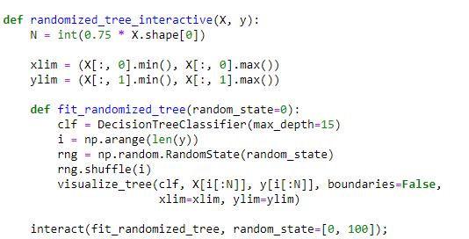
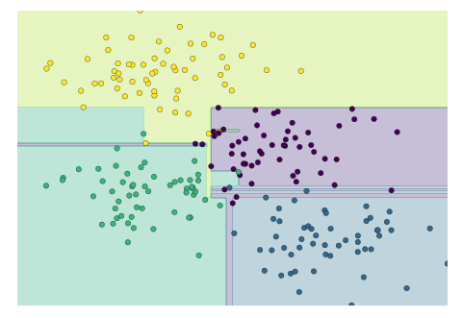
Just as using information from two trees improves our results, we might expect that using information from many trees would improve our results even further.
Notes:
جمعت ال 2 trees .. هذه الحركة اسمها ensemble

Slide 10
Ensembles of Estimators (To solve the overfitting)
This notion—that multiple overfitting estimators can be combined to reduce the effect of this overfitting—is what underlies an ensemble method called *bagging*.
Bagging makes use of an ensemble (a grab bag, perhaps) of parallel estimators, each of which over-fits the data, and averages the results to find a better classification.
An ensemble of randomized decision trees is known as a random forest
This type of bagging classification can be done manually using Scikit-Learn's ``BaggingClassifier`` and automatically``RandomForestClassifier`` estimator.

Slide 11
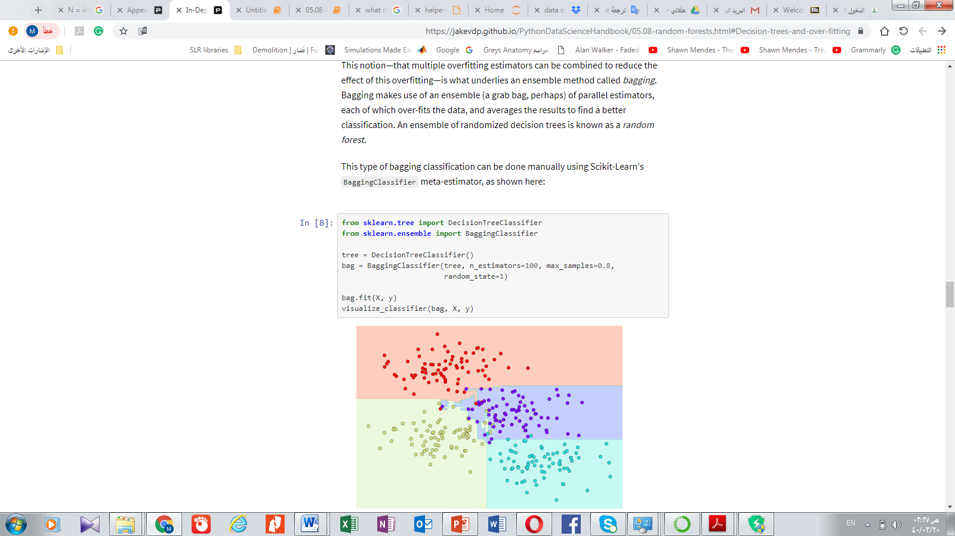
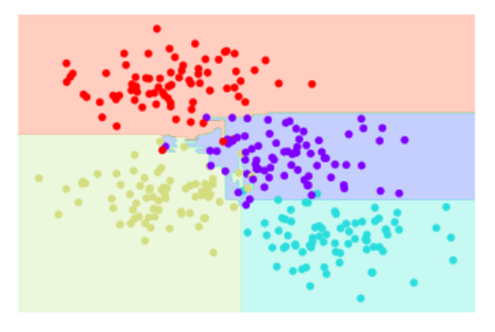

Slide 12
In this example, we have randomized the data by fitting each estimator with a random subset of 80% of the training points. In practice, decision trees are more effectively randomized by injecting some stochasticity in how the splits are chosen: this way all the data contributes to the fit each time, but the results of the fit still have the desired randomness. For example, when determining which feature to split on, the randomized tree might select from among the top several features. You can read more technical details about these randomization strategies in the Scikit-Learn documentation and references within.

Slide 13
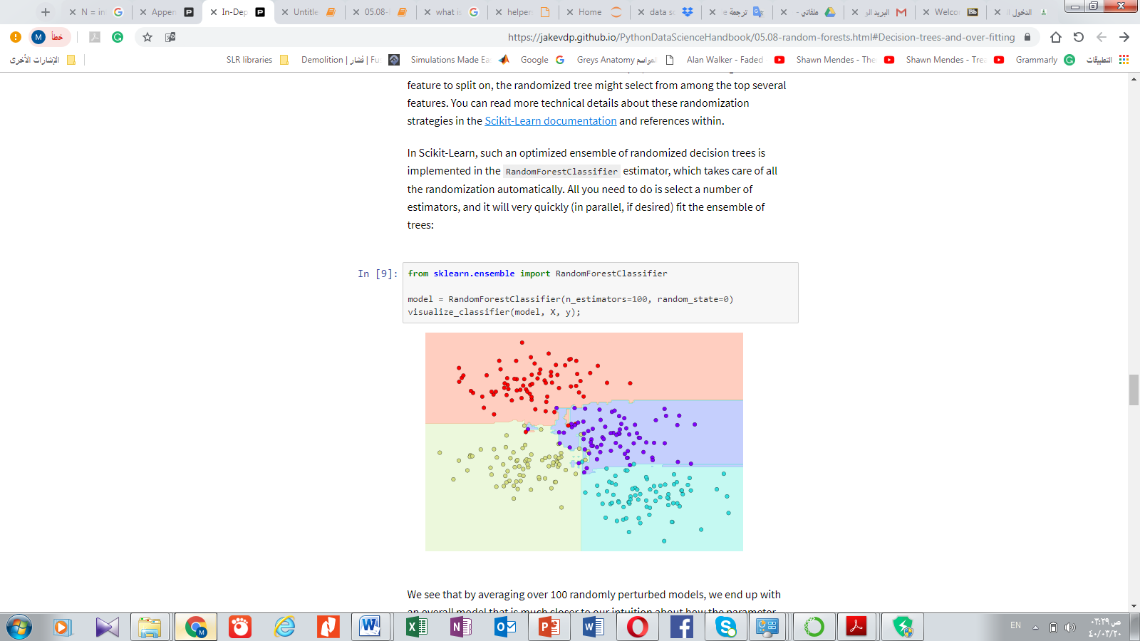
In Scikit-Learn, such an optimized ensemble of randomized decision trees is implemented in the ``RandomForestClassifier`` estimator, which takes care of all the randomization automatically.
All you need to do is select a number of estimators, and it will very quickly (in parallel, if desired) fit the ensemble of trees:
We see that by averaging over 100 randomly perturbed models, we end up with an overall model that is much closer to our intuition about how the parameter space should be split.
From 100 trees, here are the best results of best splits (relies on best optimal features)

Slide 14
Random decision trees
Random forest classification
Notes:
They are similar
n_estimators = number of trees.

Slide 15
Random Forest Regression
Random forests can also be made to work in the case of regression (that is, continuous rather than categorical variables). The estimator to use for this is the ``RandomForestRegressor``, and the syntax is very similar to what we saw earlier.
Notes:
هنا randomstate=42 يعني كل مرة في التنبؤ ياخذ نتايج مختلفة، كذلك عندما يكون randomstate=0 راح يثبت النتائج، بحيث تطلع كل مرة نفس نتيجة التنبؤ.

Slide 16
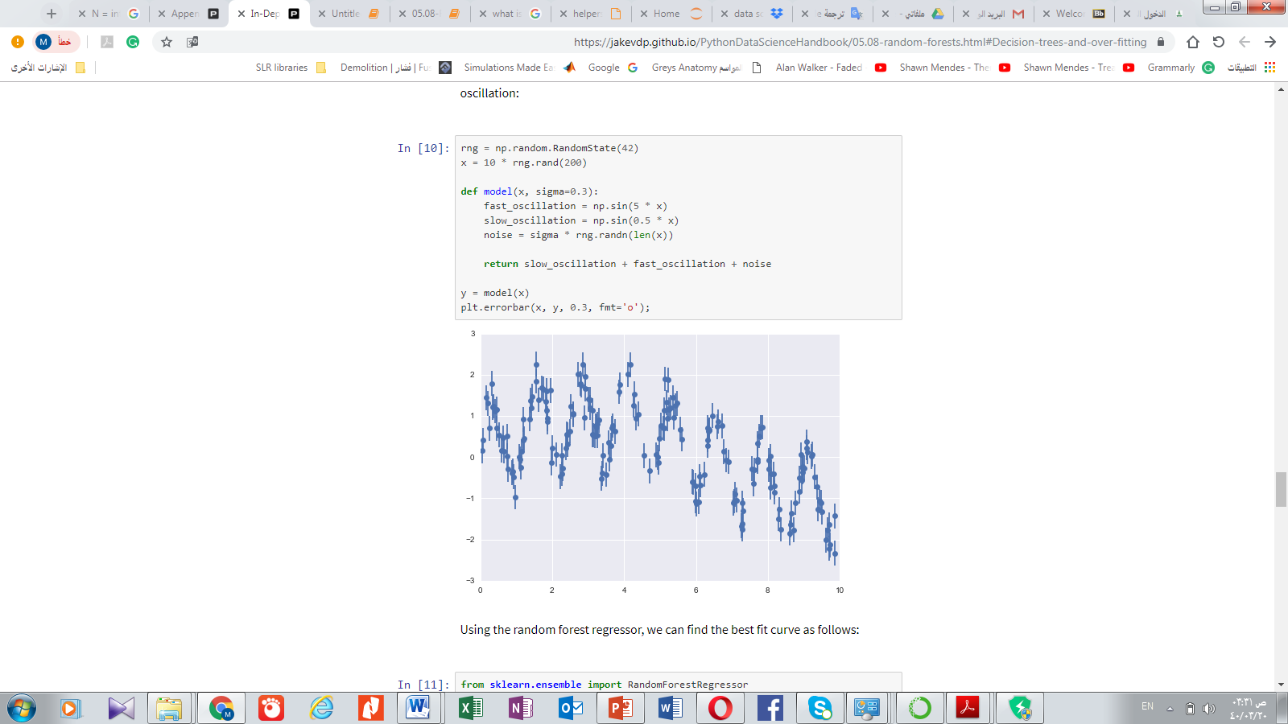
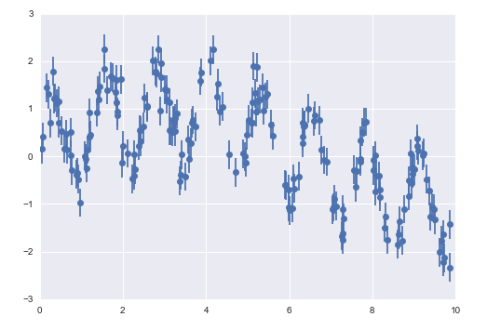
Consider the following data, drawn from the combination of a fast and slow oscillation:
Notes:
rng = np.random.RandomState(42) is Class Container for the random number generator
X independent Y dependant,
Rand(200) = Random values in a given shape.
The sine is one of the fundamental functions of trigonometry (the mathematical study of triangles).
fmt : plot format string, optional, default: ‘’
noise = sigma * rng.randn(len(x)) :
Rand is used to Return a sample (or samples) from the “standard normal” distribution, used to set the distance between dots.
plt.errorbar(x, y, 0.3, fmt='o’):
x, y define the data locations
with size of 0.3 for the error bar for every point

Slide 17
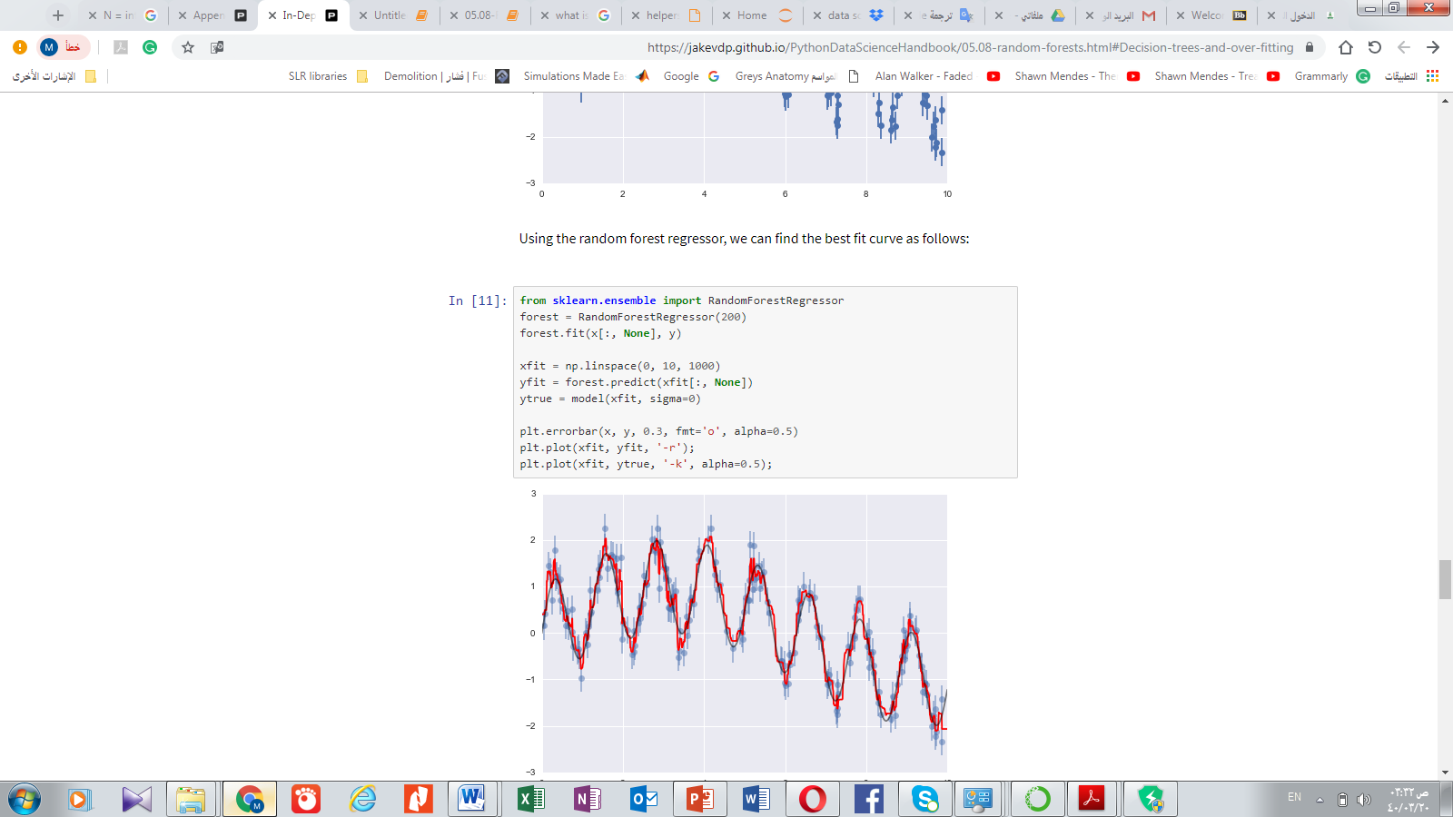
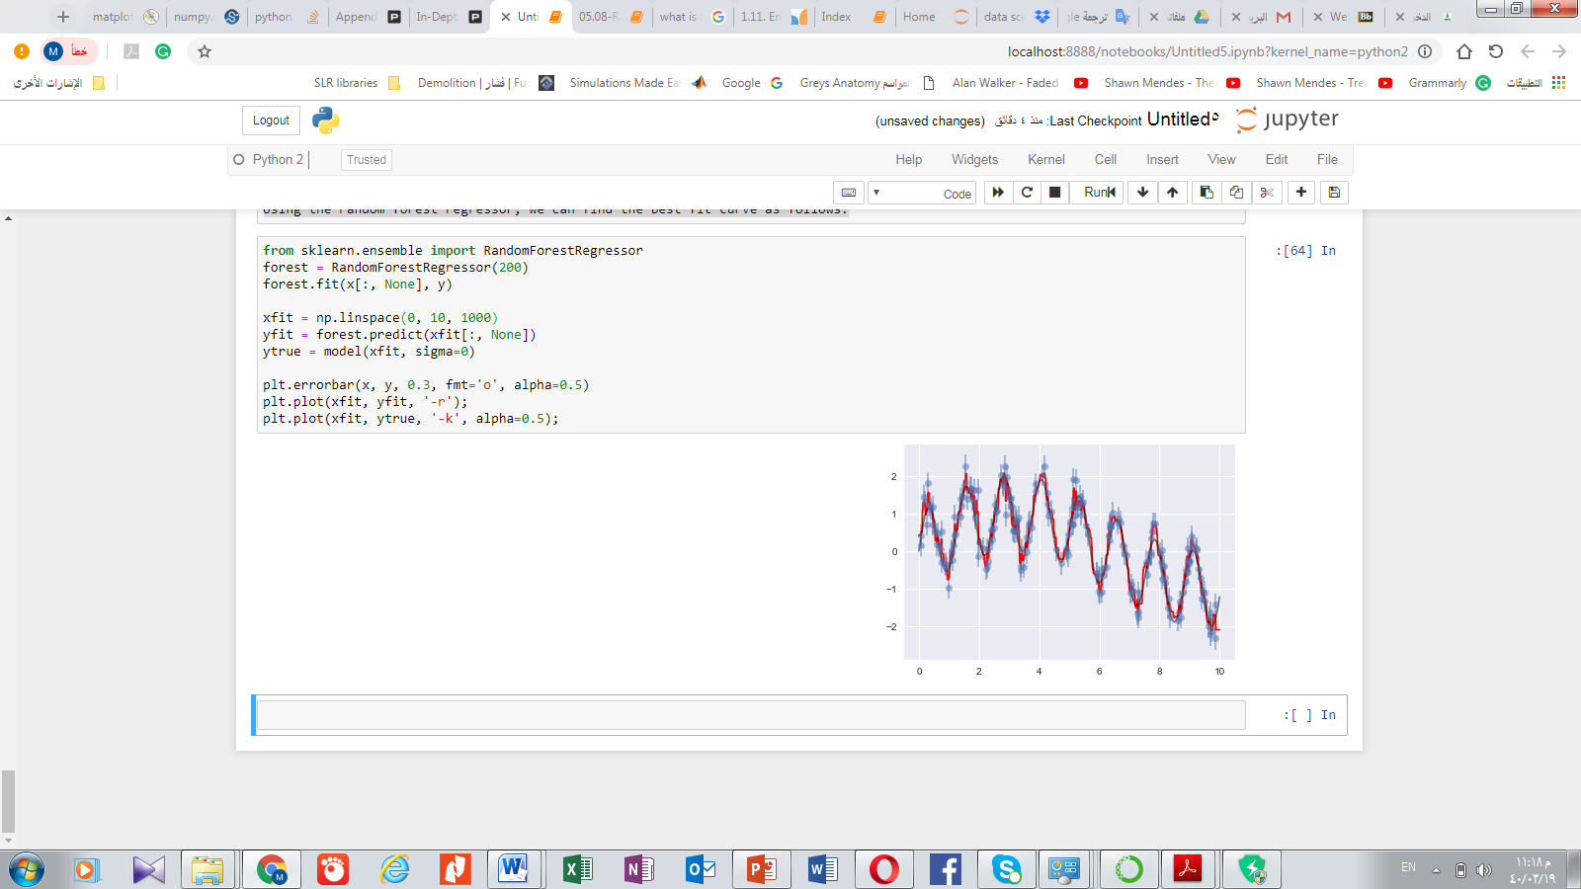
Using the random forest regressor, we can find the best fit curve as follows:
Here the true model is shown in the smooth gray curve, while the random forest model is shown by the jagged red curve. As you can see, the non-parametric random forest model is flexible enough to fit the multi-period data, without us needing to specifying a multi-period model!
Notes:
alpha=0.5 alpha is the major if transparency .
xfit = np.linspace(0, 10) : start with 0 and end 1ith 10. in x axes.
forest.fit(x[:, None], y): Build a forest of trees from the training set (X, y)
forest.predict: Predict regression target for X.
Segma: to define the space between the points. Connect the points together exactly.
fmt : plot format string, optional, default: ‘’
-r : red color
-k : black color.

Slide 18
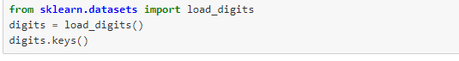
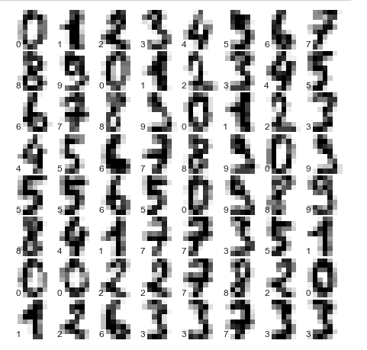
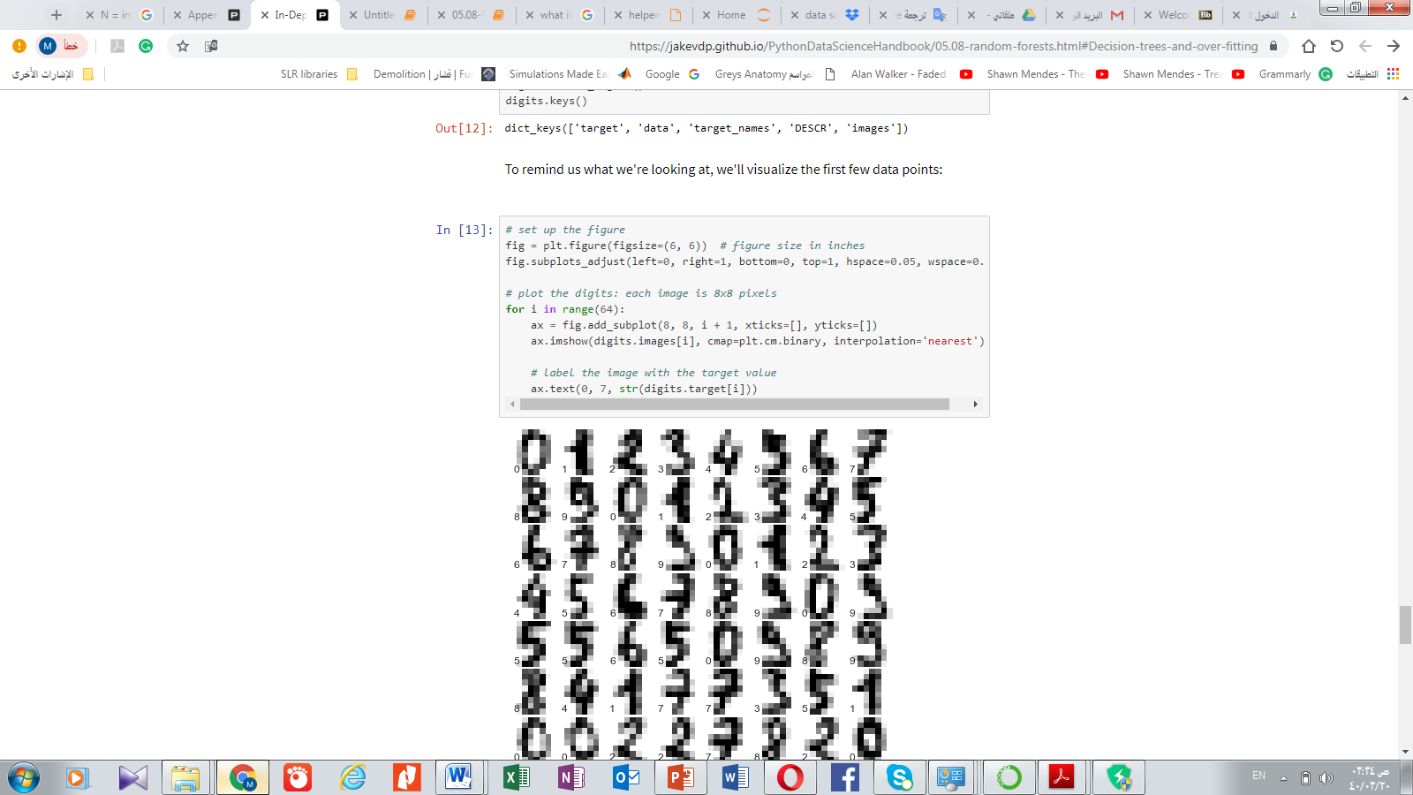
Example: Random Forest for Classifying Digits
to see how the random forest classifier can be used in the hand-written digits data
['images', 'data', 'target_names', 'DESCR', 'target’]
we'll visualize the first few data points:
Notes:
import load_digits: Load and return the digits dataset (classification).
load_digits()

Slide 19
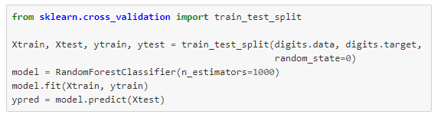
A random forest is a meta estimator that fits a number of decision tree classifiers on various sub-samples of the dataset and uses averaging to improve the predictive accuracy and control over-fitting.

Slide 20
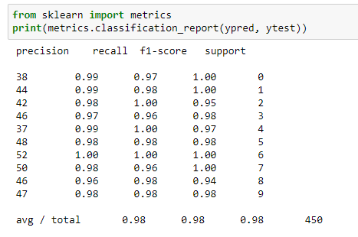
In this example we use random forest to improve the predictive accuracy and control over-fitting.
F1-score is high = high accuracy
Notes:
Compute precision, recall, F-measure and support for each class
The precision is the ratio tp / (tp + fp) where tp is the number of true positives and fp the number of false positives. The precision is intuitively the ability of the classifier not to label as positive a sample that is negative.
The recall is the ratio tp / (tp + fn) where tp is the number of true positives and fn the number of false negatives. The recall is intuitively the ability of the classifier to find all the positive samples.
The F-beta score can be interpreted as a weighted harmonic mean of the precision and recall, where an F-beta score reaches its best value at 1 and worst score at 0.
The F-beta score weights recall more than precision by a factor of beta. beta == 1.0 means recall and precision are equally important.
The support is the number of occurrences of each class in y_true.

Slide 21
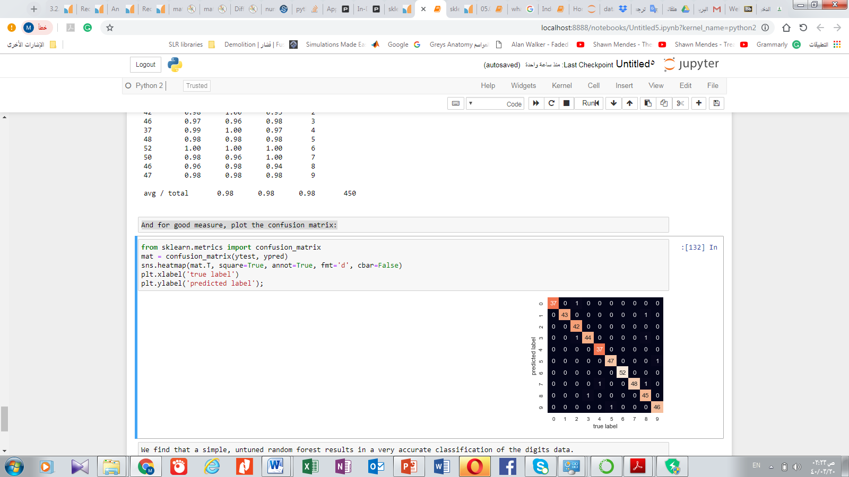

And for good measure, plot the confusion matrix:
We find that a simple, untuned random forest results in a very accurate classification of the digits data.

Slide 22
Summary of Random Forests
This section contained a brief introduction to the concept of *ensemble estimators*, and in particular the random forest – an ensemble of randomized decision trees.
Random forests are a powerful method with several advantages:
Both training and prediction are very fast, because of the simplicity of the underlying decision trees. In addition, both tasks can be straightforwardly parallelized, because the individual trees are entirely independent entities.
The multiple trees allow for a probabilistic classification: a majority vote among estimators gives an estimate of the probability (accessed in Scikit-Learn with the ``predict_proba()`` method).
The nonparametric model is extremely flexible, and can thus perform well on tasks that are under-fit by other estimators.
A primary disadvantage of random forests is that the results are not easily interpretable: that is, if you would like to draw conclusions about the *meaning* of the classification model, random forests may not be the best choice.

